Slide 1
Misai Man Company E-commerce website
Name: Ong Chee Soon
Student ID: 051150012
Course Title: SE PROJECT

Slide 2
Introduction
Misai Man herbal tea company is the family business. The location of the company is 24K, JALAN DATOH 30000 Ipoh, Perak. I am honored to develop a web page for Misai Man Herbal Tea to help them complete my final year project. In the beginning, I went to the boss of Misai Man Company to discuss what their company's website needs are, listen to their business ideas, and help them visually and technically make the entire business website.
Misai Man mainly develops modern herbal teas suitable for the modern human body according to the characteristics of modern environment, diet and physique. Misai Man's herbal tea combines the modern prescription of modern climate environment and modern people's life characteristics, especially when the weather is hot, the prescription clears heat and detoxifies without harming the body, and has strong detoxification and anti-alcoholic effects, which is more suitable for modern times People drink it, which is also a significant difference from other herbal teas.

Slide 3
Literature Review

Slide 4
COMPARISON WITH OPEN SOURCE AND CLOSED SOURCE
Open source code, which refers to a software release model. General software can only obtain binary executable files that have been compiled, and usually only the author or copyright owner of the software owns the original code of the program. Some software authors will disclose the source code, which is called "source code disclosure", but this does not necessarily meet the definition and conditions of "open source code", because the author may set restrictions on the source code disclosure, such as Restrict objects that can read the source code, restrict derivatives, etc

Slide 5
COMPARISON WITH OPEN SOURCE AND CLOSED SOURCE
The open sources main advantages are:
Lesser hardware costs.
High-quality software.
No vendor lock-in.
Integrated management.
Simple license management.
Lower software costs.
Abundant support.
Scaling and consolidating.

Slide 6
COMPARISON WITH OPEN SOURCE AND CLOSED SOURCE
The closed source is that the source code of the program is not open to the public, that is, you can't see how the source code of the software is written from the surface of the software. Closed source code software is software that keeps source code safe and encrypted. This means that users cannot copy, modify, or delete parts of the code without some consequences. It can range from invalidating the warranty to legal consequences.

Slide 7
COMPARISON WITH OPEN SOURCE AND CLOSED SOURCE
In this regard, open source software is more secure than closed source software. Besides, open source software allows users to evaluate how secure the software is by themselves because they have the access to its source code. That is not possible for closed source software.

Slide 8
COMPARISON ON BOOTSTRAP AND FOUNDATION
Bootstrap is a concise, intuitive, and powerful front-end development framework based on HTML, CSS, and JavaScript developed by Mark Otto and Jacob Thornton, a designer of American Twitter, which makes Web development faster. Bootstrap provides elegant HTML and CSS specifications, it is written by the dynamic CSS language Less. Bootstrap has been popular since its launch and has been a popular open source project on GitHub, including Breaking News from NASA's MSNBC (Microsoft National Broadcasting Corporation).

Slide 9
COMPARISON ON BOOTSTRAP AND FOUNDATION
Foundation is an open source front-end framework that we can use to quickly create page prototypes. Compared to other tools of the same type, Foundation ’s mobile solution is even better; drawing on the ideas and methods of responsive web design, Foundation makes corresponding presets for the presentation of content structures on different types of devices.

Slide 10
COMPARISON ON BOOTSTRAP AND FOUNDATION
Bootstrap and Foundation can be primarily classified as "Front-End Frameworks" tools.
Some of the features offered by Bootstrap are:
Preprocessors: Bootstrap ships with vanilla CSS, but its source code utilizes the two most popular CSS preprocessors, Less and Sass. Quickly get started with precompiled CSS or build on the source.
One framework, every device: Bootstrap easily and efficiently scales your websites and applications with a single code base, from phones to tablets to desktops with CSS media queries.
Full of features: With Bootstrap, you get extensive and beautiful documentation for common HTML elements, dozens of custom HTML and CSS components, and awesome jQuery plugins.

Slide 11
COMPARISON ON BOOTSTRAP AND FOUNDATION
On the other hand, Foundation provides the following key features:
Semantic: Everything is semantic. You can have the cleanest markup without sacrificing the utility and speed of Foundation.
Mobile First: You can build for small devices first. Then, as devices get larger and larger, layer in more complexity for a complete responsive design.
Customizable: You can customize your build to include or remove certain elements, as well as define the size of columns, colors, font size and more.

Slide 12
COMPARISON WITH PHP LANGUAGE AND JAVA LANGUAGES
PHP and Java are two popular programming languages. PHP and Java, as two completely different programming languages, have different expressions in terms of technical level, development space, or market share, and the different concepts have led to the development of Java and PHP in Web application development.

Slide 13
COMPARISON WITH PHP LANGUAGE AND JAVA LANGUAGES
PHP and Java are two popular programming languages. PHP and Java, as two completely different programming languages, have different expressions in terms of technical level, development space, or market share, and the different concepts have led to the development of Java and PHP in Web application development.
PHP is a scripting language that interprets and executes. The syntax is similar to C language. It is easy to learn and use. Non-professionals who do not understand computers can use PHP after a little learning; Java needs to be compiled into Class files first Executed on a Java virtual machine, Java development requires familiarity with Java syntax and some core architectures to implement a reusable, cross-platform software. Java is much more difficult to learn than PHP.

Slide 14
COMPARISON WITH PHP LANGUAGE AND JAVA LANGUAGES
The main difference between PHP and Java is in implementation. Java is compiled into bytecode and run on a JVM. PHP, on the other hand, is an interpreted language. It is first compiled into bytecode and then interpreted by a runtime engine.

Slide 15
COMPARISON WITH THE E-COMMERCE TAOBAO SHOPPING CART FUNCTION
Adding a shopping cart is a function that every consumer knows. In fact, the function of adding a shopping cart is very important for Taobao merchants. Therefore, many merchants want to do shopping cart marketing, but before that, they do not know how much shopping cart marketing can bring to the store. Shopping cart marketing is a very good Taobao shop marketing tool launched by Taobao officials two years ago. Through shopping cart marketing, Taobao sellers can get all the data on the shopping cart on Taobao. Therefore, as a Taobao seller, they can very clearly understand the potential customer service of the goods they operate in their stores.

Slide 16
COMPARISON WITH THE E-COMMERCE TAOBAO SHOPPING CART FUNCTION
What are the benefits of adding a shopping cart to Taobao merchants? I believe every Taobao merchant knows the Taobao search algorithm with thousands of people and faces. Taobao will pass a lot of data, and put a lot of tags on every product and every user on Taobao. When the label of the product and the user are the same, the correct product will be pushed to the right person. This is why many merchants want to increase the possibility of adding to the shopping cart.

Slide 17
RESEARCH ON THE APPLICATION OF DIV + CSS LAYOUT TECHNOLOGY IN WEB DESIGN
DIV + CSS layout technology, that is, the layout technology that is applied in XHTML websites. This technology deviates from the traditional Table technology and completes the positioning in each web page through the form of DIV + CSS. The DIV element is mainly an element that provides structure and background for the HTML document. The DIV element can divide the document into several modules with different meanings, and all the content covered between the start tag and the end tag in the DIV is composed The main elements of the module, the attributes of these elements are controlled by the influence of DIV tag attributes.

Slide 18
RESEARCH ON THE APPLICATION OF DIV + CSS LAYOUT TECHNOLOGY IN WEB DESIGN
CSS is a cascading style sheet, which is mainly used to control the style of web pages, and is also a markup language that separates style information and web page content. Through the use of CSS, it is possible to control the page layout very well and achieve the separation of structure and format. The use of related technologies makes web pages with faster download speed and smaller size.

Slide 19
COMPARE WITH THE WATERFALL AND THE AGILE
The waterfall model is a method of decomposing a project into limited stages to develop software. Only when the previous stage is reviewed and verified, the development should proceed to the next stage. In the waterfall model, the stages do not overlap. In this method, the sequence of events is this: I) collect and record requirements, 2) design, 3) code and unit tests, 4) perform system tests, 5) perform user acceptance tests (UAT), 6) resolve Any problem, 7) Deliver the finished product.

Slide 20
COMPARE WITH THE WATERFALL AND THE AGILE
Agile is an iterative, team-based development method. This approach emphasizes the rapid delivery of applications with complete functional components. All time is divided into "sprint (usually called iteration)" stages by the "fixed time box". Instead of creating tasks and schedules. Each iteration cycle has a defined duration (usually in weeks), which contains a running list of deliverables planned at the beginning of the iteration. The deliverables are prioritized according to the business value determined by the customer. If all the planned work in the iteration cannot be completed, the work will be reordered and the information will be used for future iteration planning. When the work is completed, the project team and customers can review and evaluate it through daily builds and iterative demonstrations. Agile relies on a very high level of customer participation throughout the project, especially during these reviews.

Slide 21
METHODOLOGY

Slide 22
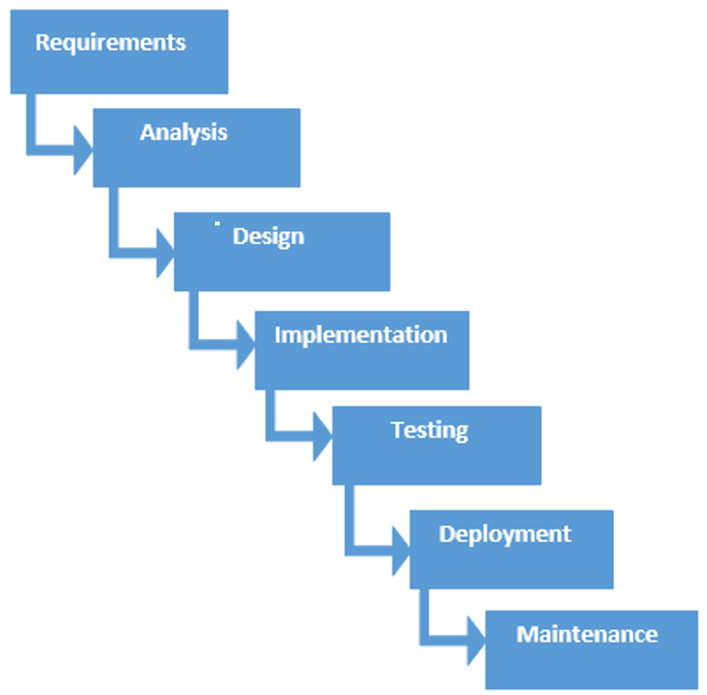
CHOSEN METHODOLOGY
I use the waterfall model for development, from the beginning of system requirements analysis to product release and maintenance, each stage will generate circular feedback.

Slide 23
APPLICATION OF CHOSEN METHODOLOGY
There are 7 stages in the Waterfall model. My final project is to analyze, design, implement, test, and deploy according to requirements. In this section, I will discuss in detail each stage of this method in my final project.

Slide 24
STAGE 1,2 – REQUIREMENT ANALYSIS
At this stage, I have performed a needs analysis. After interviewing Misai Man's customers, the requirements for the proposed system were collected. Requirements include functional requirements and non-functional requirements, which is essential for system development. In the final project, the requirements provided by the user, including functional requirements and non-functional requirements, have been designed in the project.

Slide 25
STAGE 3 – DESIGN
At the stage of designing the final project, the appearance and functions of the system have been properly designed. The interface design already in the system includes the system layout, the number of links contained in a single page, the location of the navigation bar and the location of the information display. In addition, the position, color, font size and layout of Web elements have been kept consistent. In the Admin page, the administrator has been designed to see the buyer purchase information on the admin page. I have set the homepage of Misai Man website, such as homepage, about us, product and order page, contact us page, management page, user order view and payment method page. I am a front-end development framework designed with open sources Bootstrap. It makes it easy for me to make web pages the best experience on desktops, tablets and mobile phones. Therefore, I add the main function in the template, which can help me save a lot of time.

Slide 26
STAGE 4 – IMPLEMENTATION
In the implementation phase, I have created a database based on the database design generated during the design phase. I created this database using PHPMYADMIN. After creating the database, I have designed the module functions required by each user into this web page system.

Slide 27
STAGE 5 – TESTING
After designing the Misai Man e-commerce website, it has been tested as planned. The user has entered the test data according to the instructions in the test plan and checked whether the output is as expected. I have recorded if the output does not meet expectations, and then recorded it to evaluate the system. It has been ensured that the assessment will check whether the system is operating as expected. After the system check is completed, it will enter the next stage.(

Slide 28
STAGE 6 – DEPLOYMENT
At this stage of deployment, the system has met the requirements of Misai Man Company customers, and the function works as expected to support users in performing tasks. The webpage system is ready to be deployed and available to users. Therefore, I record the entire development process so that the system can be easily maintained in the future. It will also help users understand how the system operates.

Slide 29
STAGE 7 – MAINTENANCE
At this stage, the customer has finally used the application e-commerce web system. At this stage, changes that may be made due to changes in demand are implemented.

Slide 30
RESULTS AND FINDINGS

Slide 31
REQUIREMENTS GATHERING
For my analysis in the interview Part, According to the interview part the client has set three goals to make the site a success.
The first client’s goal is to increase the number of visits to the website to let more people know about our company's products. I have suggested to the client, the aesthetics of design will be an independent function section.
The second goal is to increase the average order quantity of herbal tea to increase sales.
Third goal is encouraged more people to browse our website through social networking sites to increase the brand awareness of our company.

Slide 32
SYSTEM IMPLEMENTATION & DEPLOYMENT
Bootstrap template :
The original web design page is not very beautiful, so I used bootstrap to encapsulate the front end briefly, so that the page I wrote is more beautiful. The role of bootstrap can be without the premise of art You can also design beautiful front-end pages. Bootstrap is a front-end framework for rapid development of web applications and websites. Bootstrap is based on HTML, CSS, JAVASCRIPT.

Slide 33
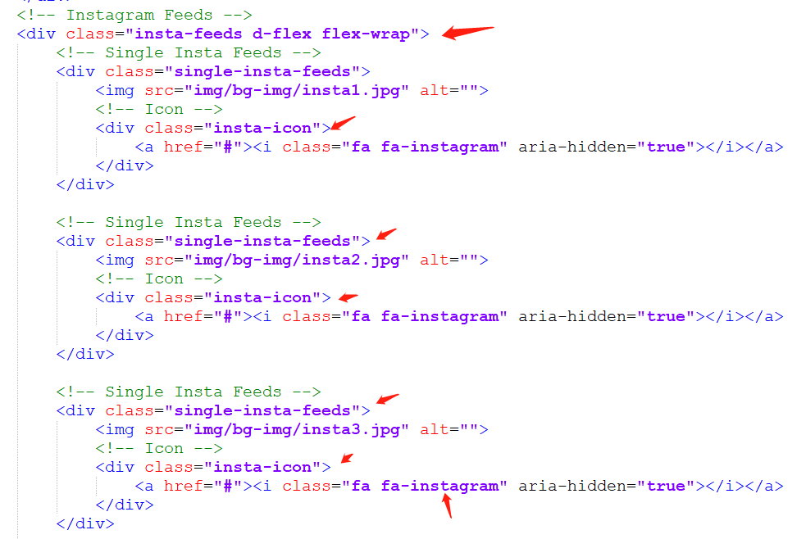
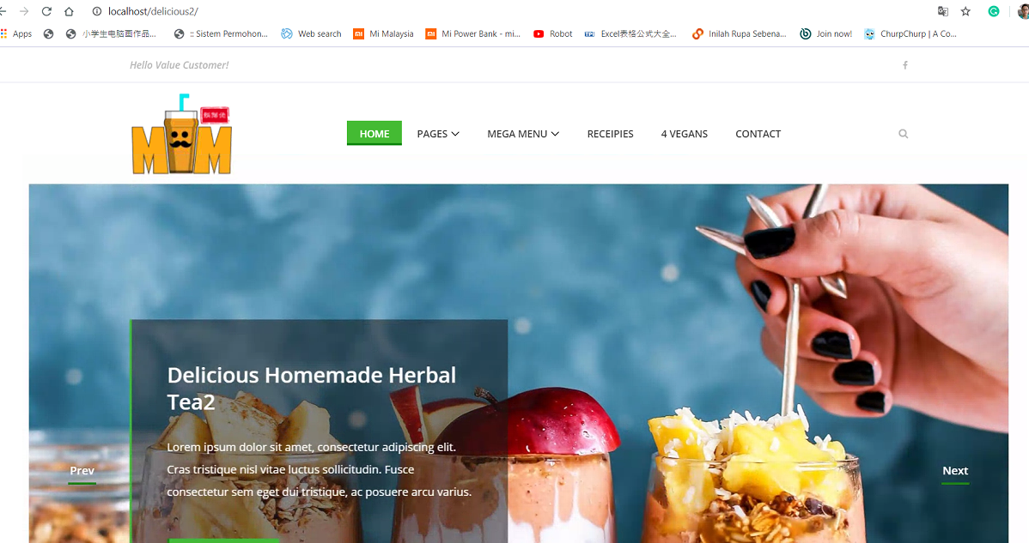
Bootstrap template

Slide 34
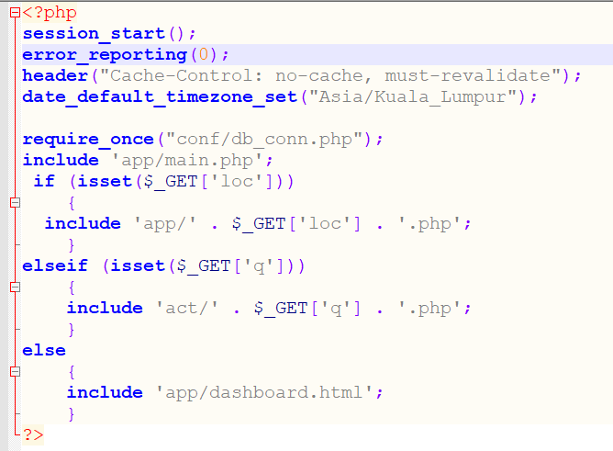
Create index file
The index.php file is the homepage of a website developed in PHP. The default index page of the website. If the URL does not enter a webpage, the network will automatically output this file as the page you see. .php is an extension of a web page written in a web programming language, similar to .html.

Slide 35
Build the database
I created a database in phpMyAdmin. I named the database name setting "delicious", where various tables will be added to save the data. The database can help me design the functions of most e-commerce databases. For example, one of the most important tasks of a database is to track and manage transactions. It aims to track every order and the detailed information needed to help Misai Man process the transaction. Processing orders requires a lot of data. This feature dominates most e-commerce databases. Another important database function is to organize products. Depending on the store, it may have thousands of products, each with different styles and styles. Organizing this combination of products and options is a key function of an e-commerce database.

Slide 36
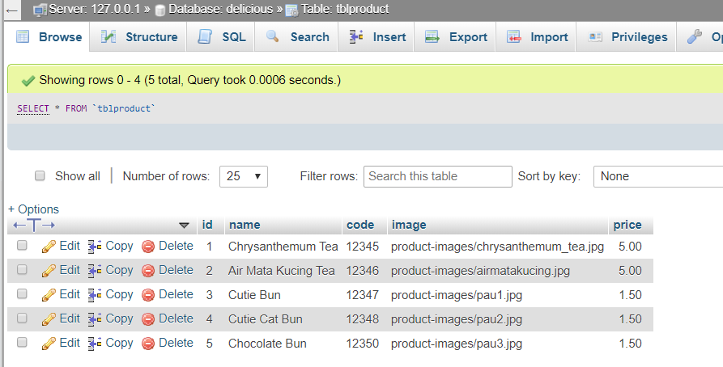
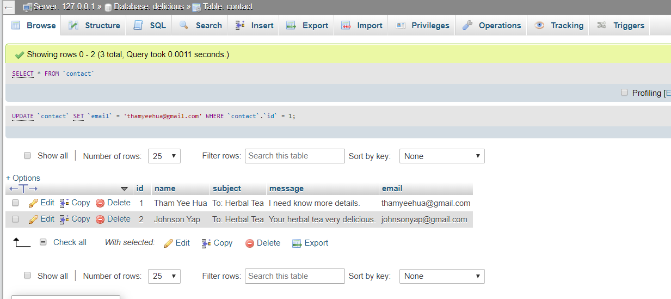
Build the database
These table is built to store product name, code, image and price. And build the contact table.

Slide 37
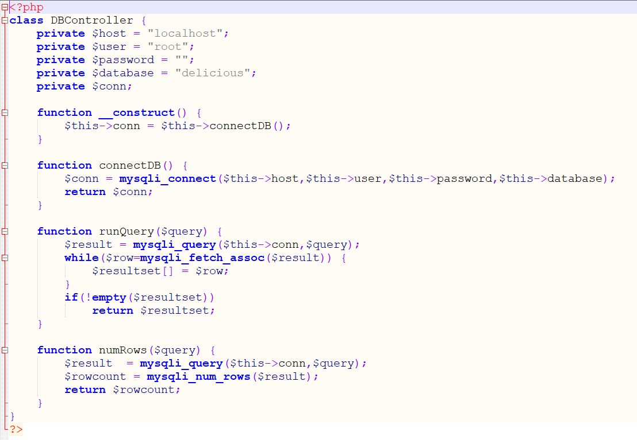
Create a file to connect the “delicious” database
I have created the “dbcontroller.php” file to connect the database. If I fill in details of database username,password, hostname and database name the this file will direct connect my database.

Slide 38
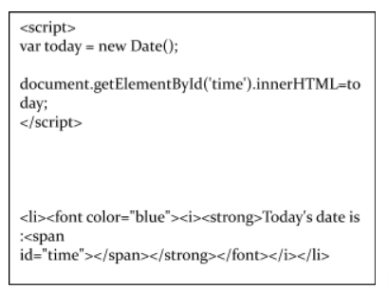
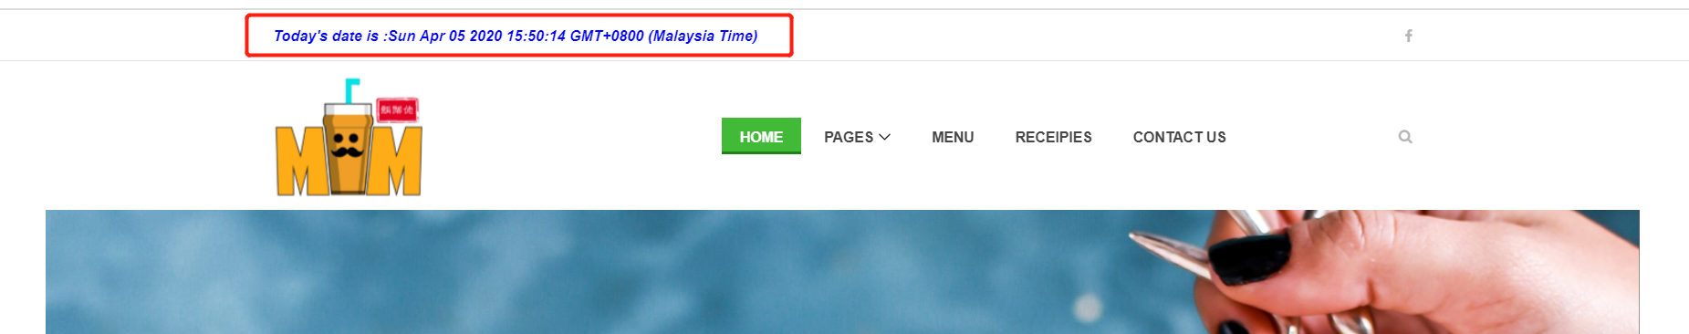
Show the current date time in the Main Page
I have created the current date time to show in the dashboard, the new Date(); coding can get the current date time .

Slide 39
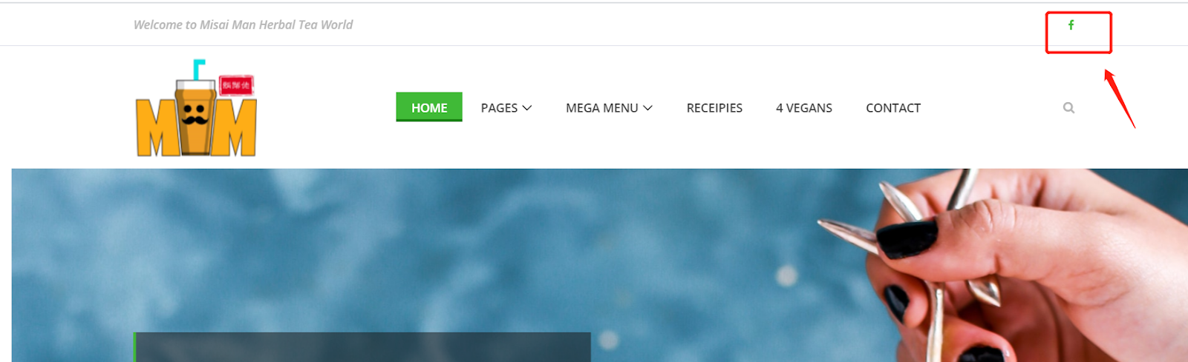
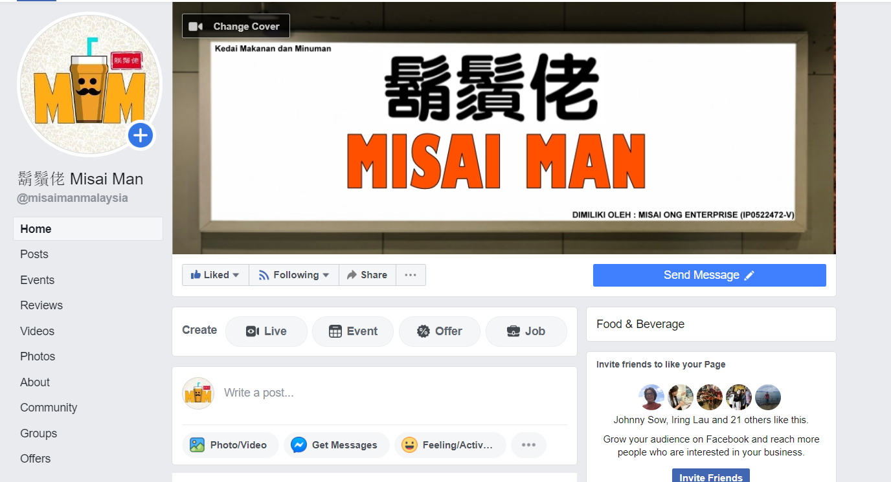
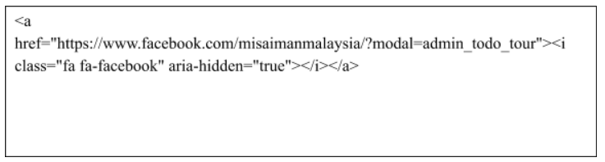
Create social media link
I have added the Misai Man social media Facebook icon in the dashboard, this is the way to let the customers to get more updated information for the Misai Man company. Below is my coding:

Slide 40
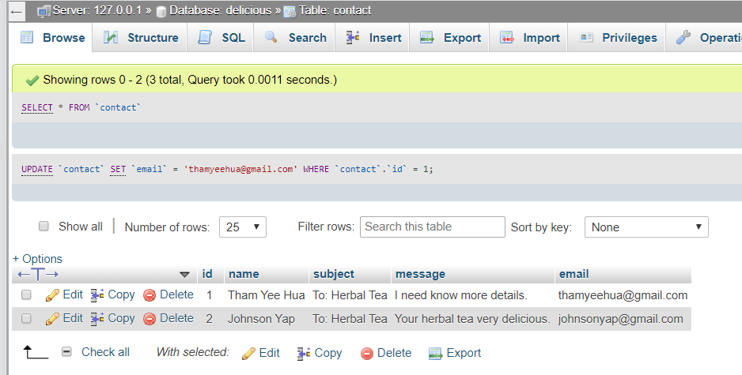
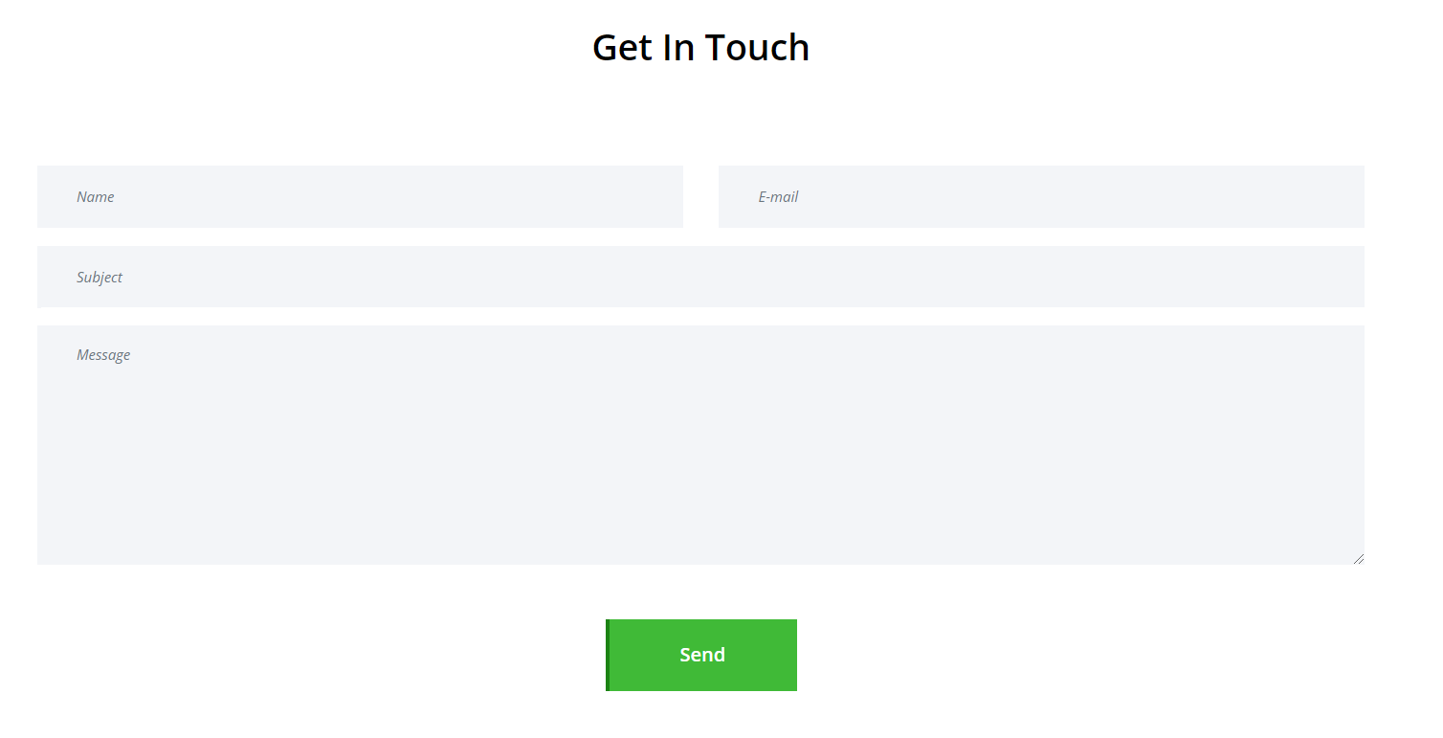
Create contact form
I have added a module for contact. It can let the visitors directly send the message to the Misai Man Herbal Tea company by the administrator.

Slide 41
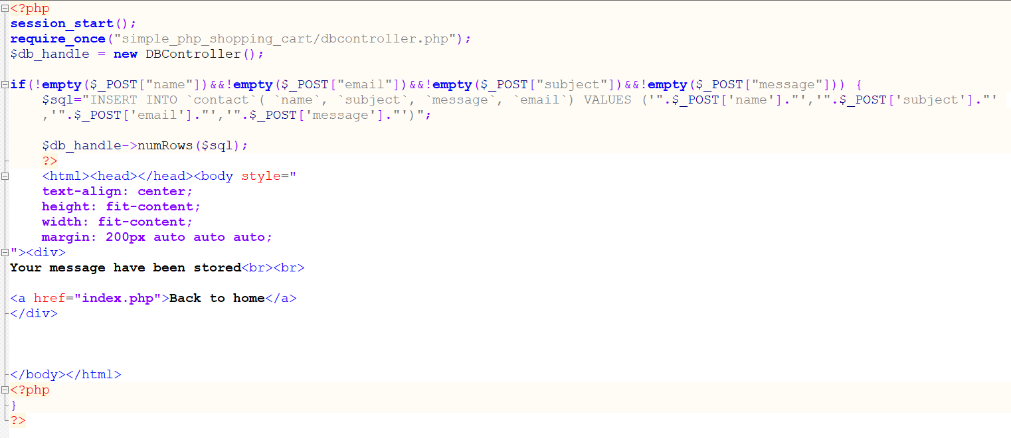
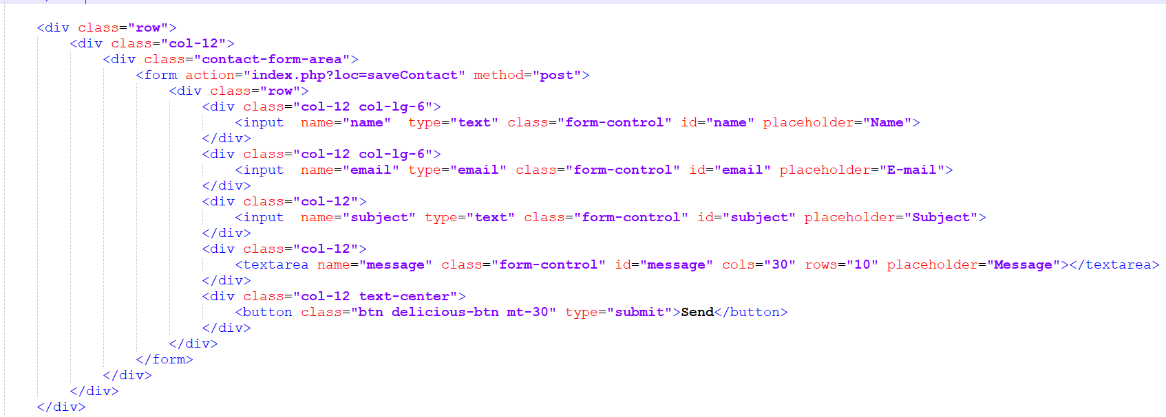
Save contact SQL functions

Slide 42
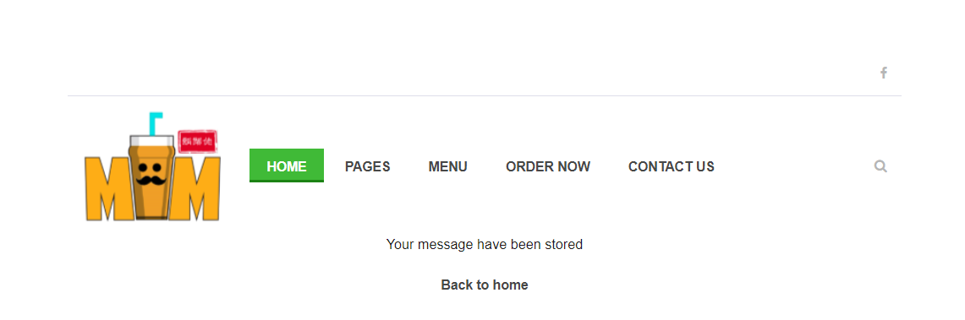
Create contact form
After the visitors click the “send” button to send the message, it will bring the visitor to the next page, it means they have successfully sent the message. After that, the visitors can click the “Back to home” to back the homepage.

Slide 43
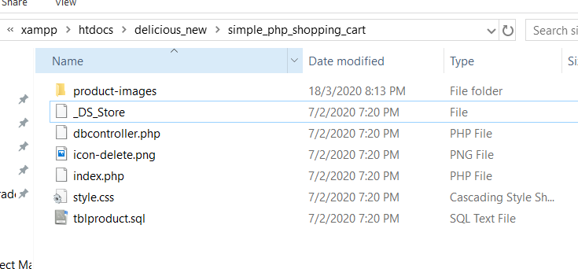
Create shopping cart
I have created a shopping cart module to let the visitor buy the company Misai Man product. And this module, first I’ve created the simple_php_shopping_cart folder. Inside the folder, contain a product-images folder to store product image, style.css file to design the shopping cart view.

Slide 44
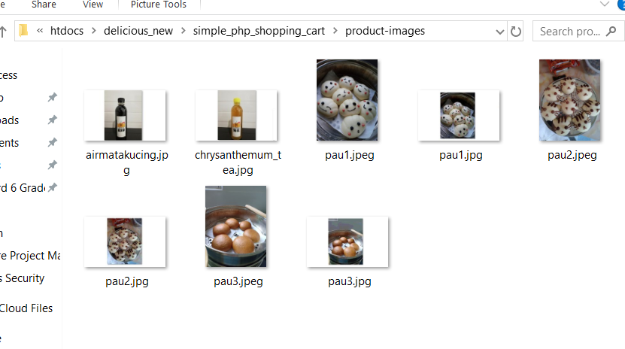
Store Product Images Folder

Slide 45
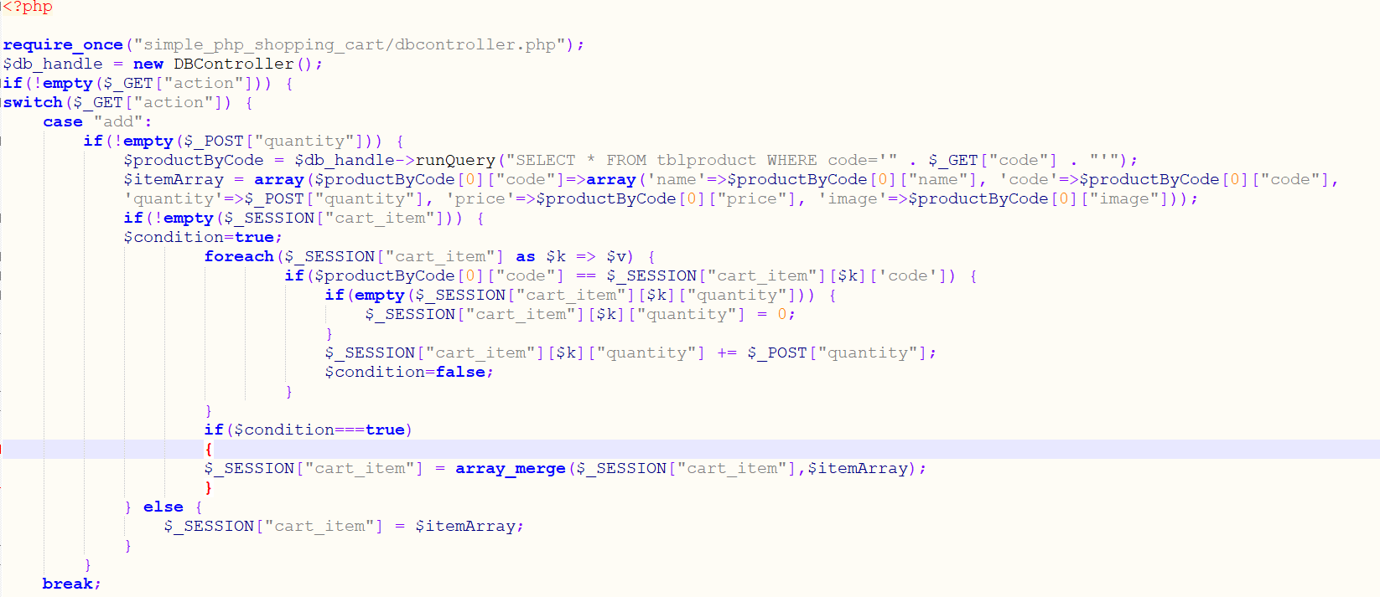
Array to get the product
I open a new file name as receipe-post.php, in this file I write the code to make the shopping cart functions work. Below is my coding will explain more:
Below the coding , first will connect the database and make it an array to get the product from visitors selected by the product, it will determine how many product the visitors selected.

Slide 46
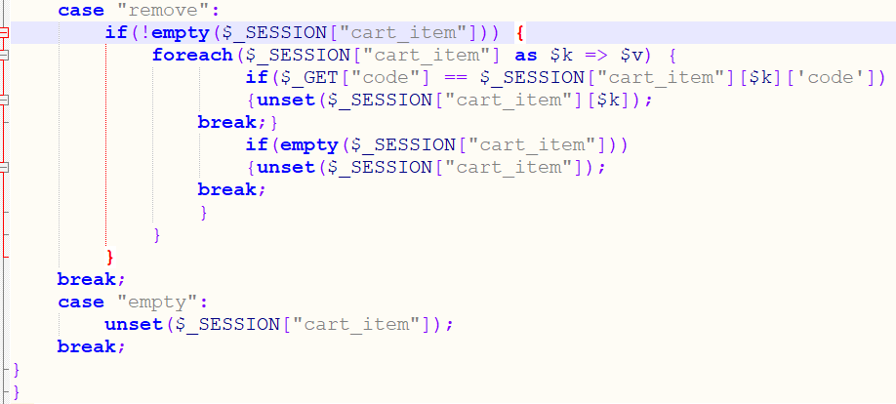
Remove the product in the cart
Below the code is shown visitors can remove what they selected from the products in the cart.

Slide 47
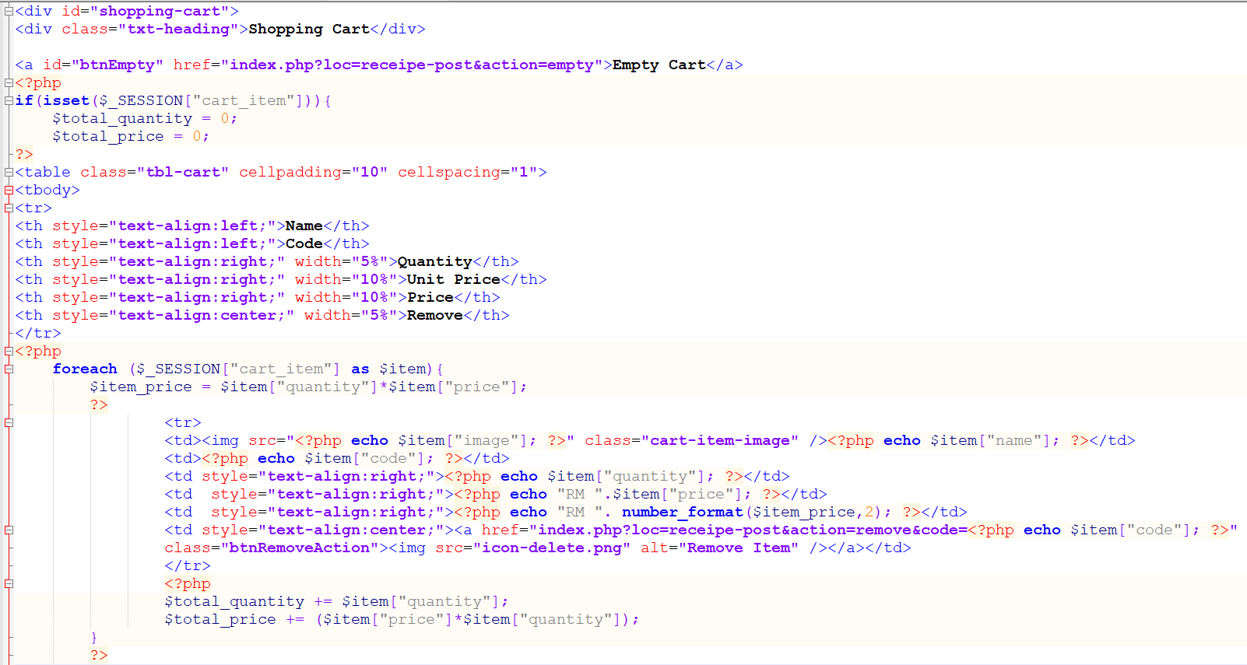
Table Shopping Cart
The coding is shown the table for visitors who have selected the product according to the product amount

Slide 48
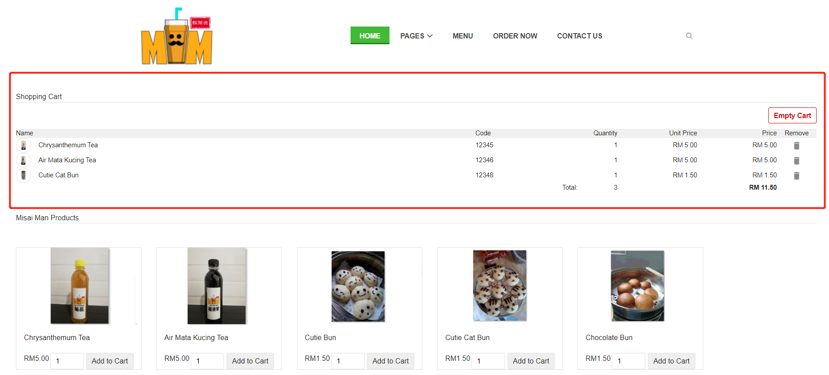
Output of Table Shopping Cart

Slide 49
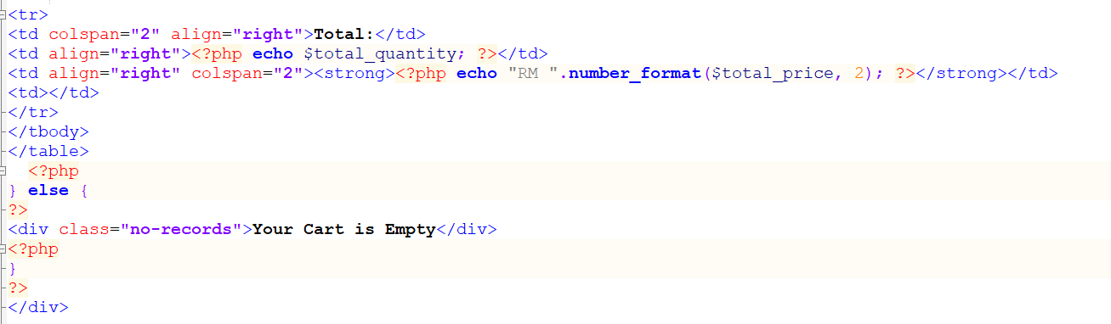
The calculation total price and quantity
The coding is shown to calculate the total of the products price and quantity, if the cart is empty, it will show the visitors know is emptied.

Slide 50
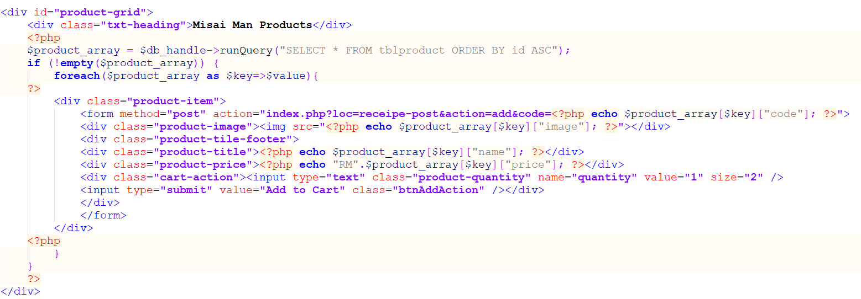
Show the product images and details coding
The coding is shown the products details is taken from the database tblproduct table. It will show the product details in the div according how many products database tblproduct table have.

Slide 51
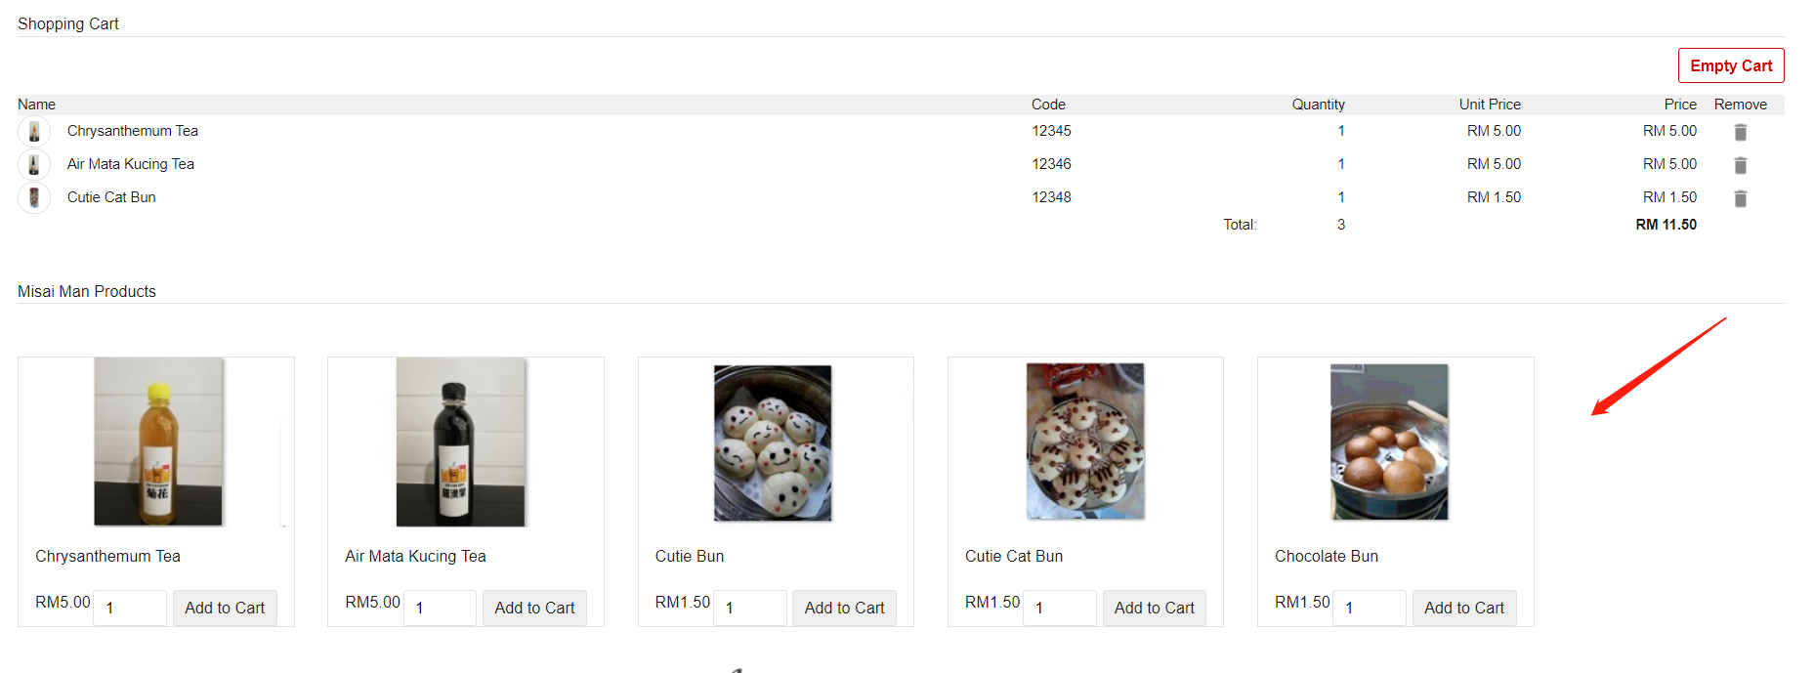
Output of the product images and details coding

Slide 52
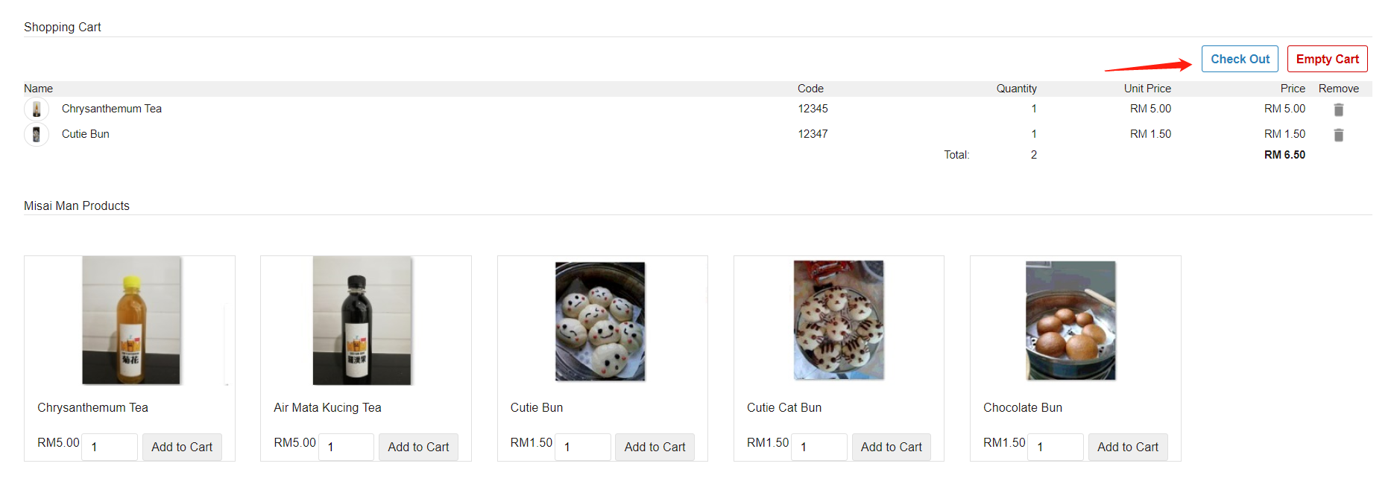
Create checkout function
I have created the checkout function to calculate total how much the visitors purchase. When the visitors have clicked the checkout function, it will go to the next page to check the payment.

Slide 53
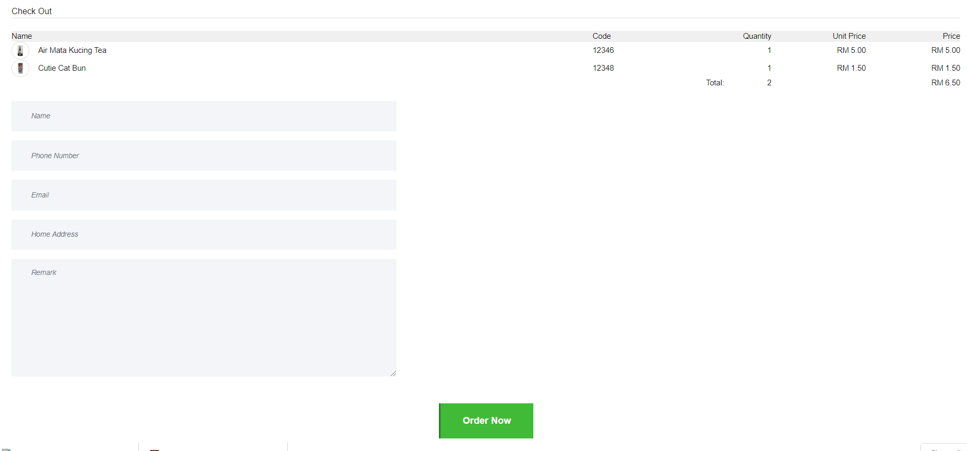
Checkout Page

Slide 54
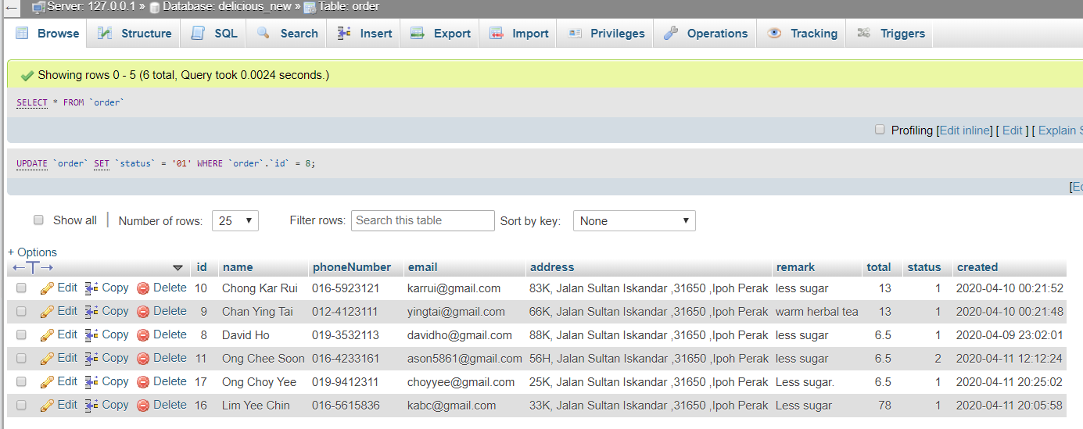
Table to keep visitors purchase record

Slide 55
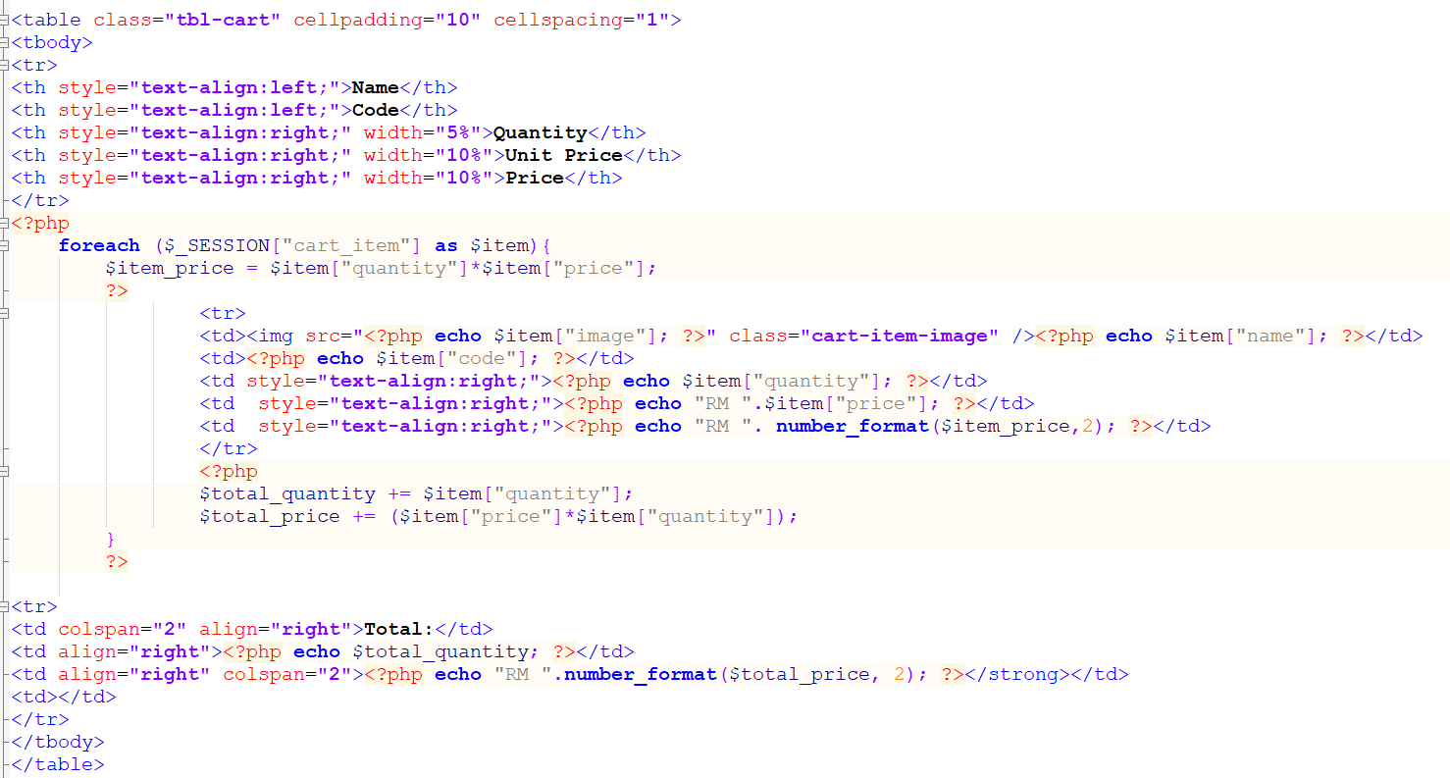
Coding of checkout function

Slide 56
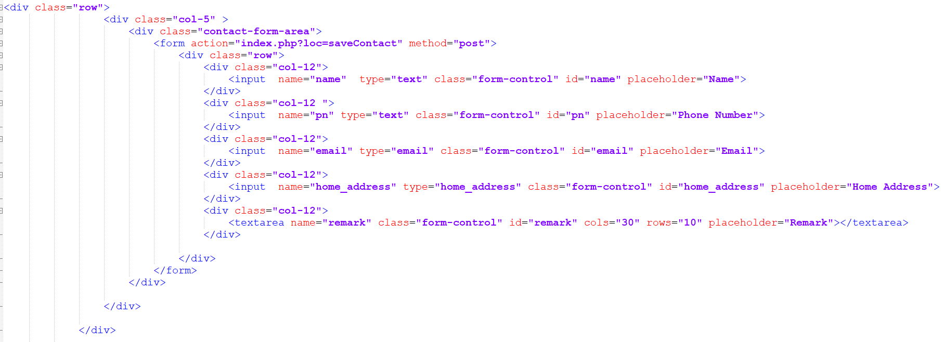
Coding of checkout function

Slide 57
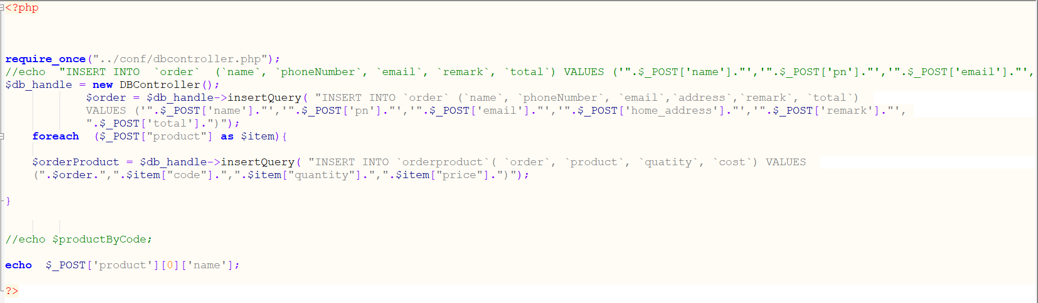
Coding of checkout function (backend)

Slide 58
Admin page
Admin page is created for the Misai Man who is in charge of the admin part. This page can let the administrator check the order from the customers. And can let the administrator check the contact us message from the visitors feedback.

Slide 59
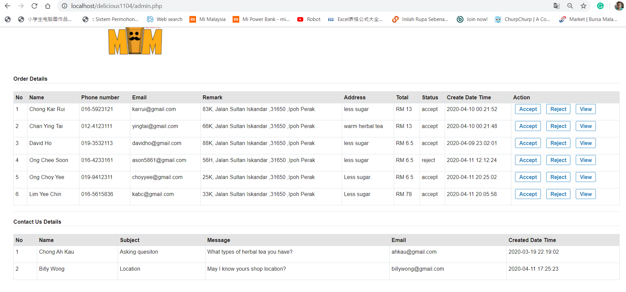
Admin page
In the order details part, the administrator can do the three actions (accept, reject and view). For the accept button, when the administrator clicks this button, the status column will show the “accept” word. For the reject button, when the administrator clicks this button, the status column will show the “reject” word.

Slide 60
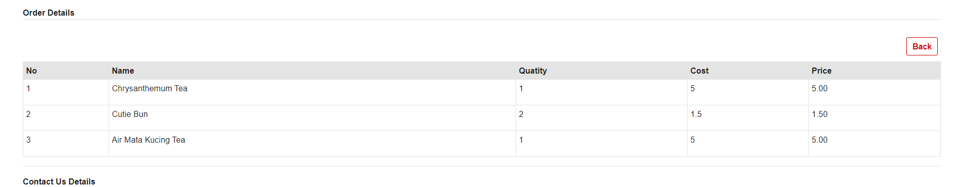
Admin page (View Order Details)
For the view button, when the administrator clicks this button, the administrator can view the customer order details. After checking the customer order details, the administrator can clicks the “Back” button to back the previous page.

Slide 61
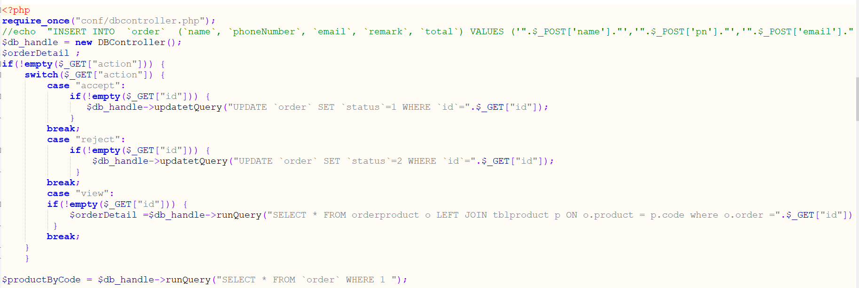
Admin Page Order Function
I have used the switch case function to do the accept, reject, view button. I’ve used updatetQuery to update the action button, and set the each button status,such as accept action status is 1, reject status action is 2 , view status is 3. Because this status will record in the “order” table.

Slide 62
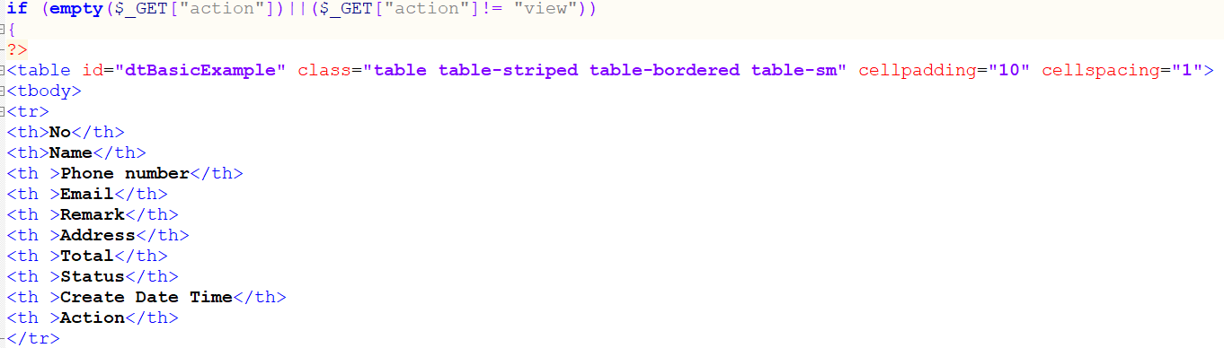
Admin Page Order Function
In this part of coding, I have used the if else function to detect the administrator if click the view button, the administrator can go in the view page to check the buyer order record.

Slide 63
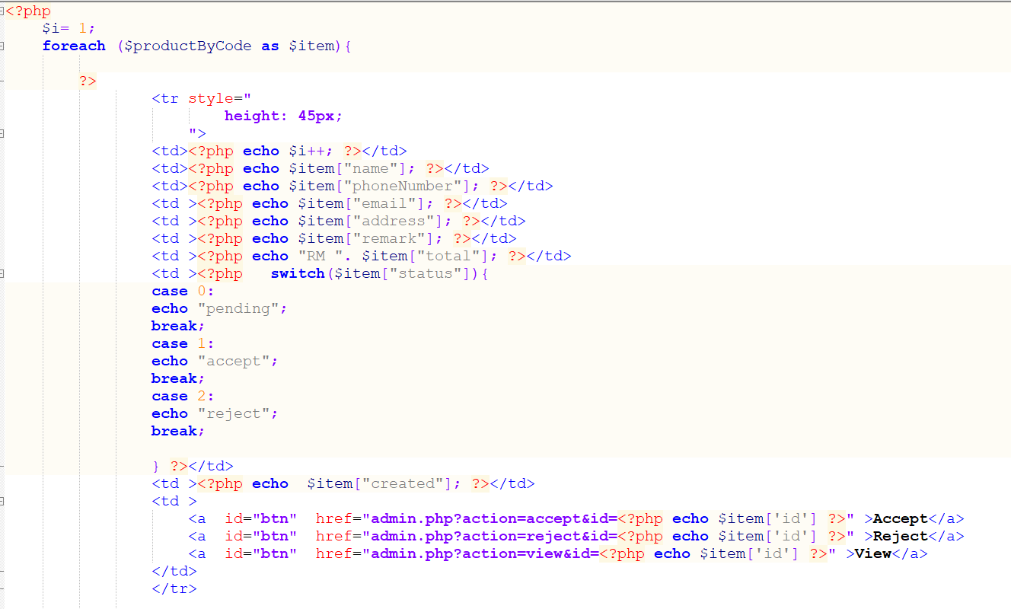
Admin Page Order Function
In this part of coding, it will echo the data and the action button from the “order” table.

Slide 64
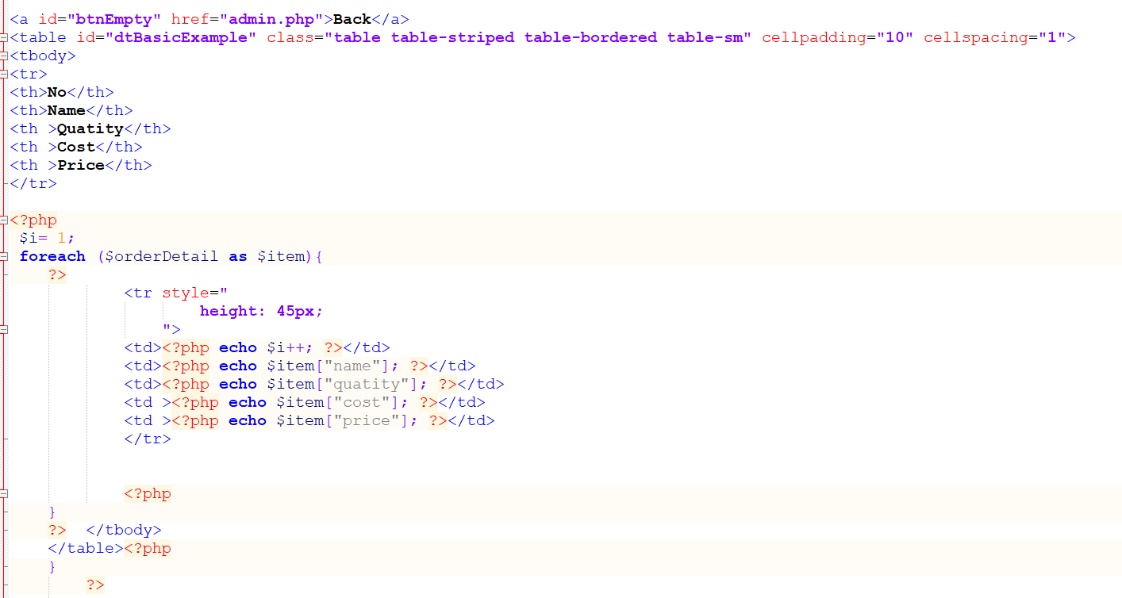
Admin Page Order Function
In this part of coding, it will show the customer order record when the administrator clicks the “View” button.

Slide 65
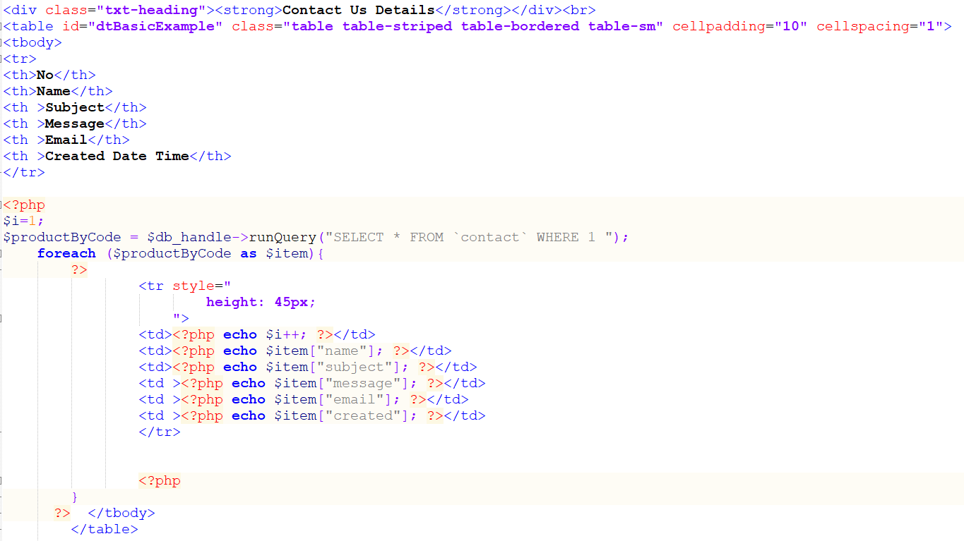
Admin Page Contact Us Details Function
In this part of coding, it will show the Contact Us Details record from the “contact” table.
Noted: If you want to see the admin page, the website behind need to put admin.php. For example: localhost/misaimanmalaysia/admin.php

Slide 66
Design
I have created and design each page in the e-commerce website. I will show you step by step.

Slide 67
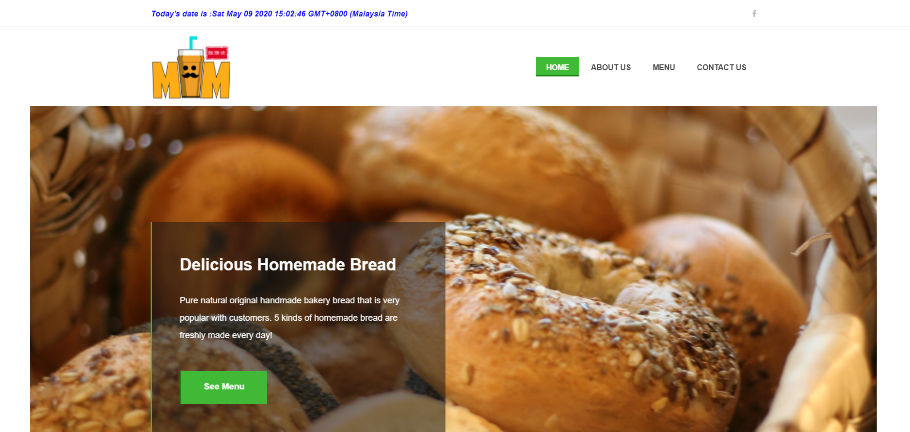
Home Page

Slide 68
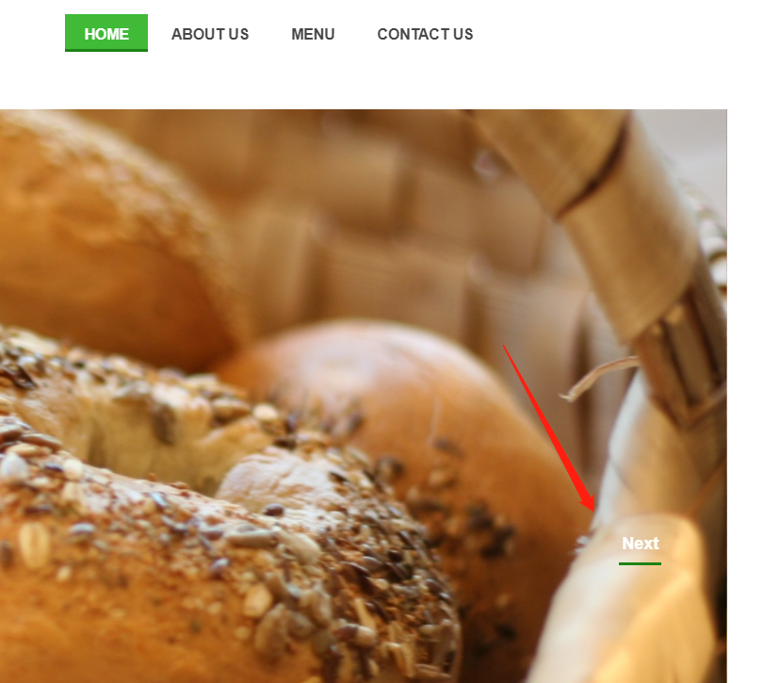
Home Page function
1. I have add the current date and time to let the customer easy to know the current date and time.
2. Can switch the slide in the dashboard.

Slide 69
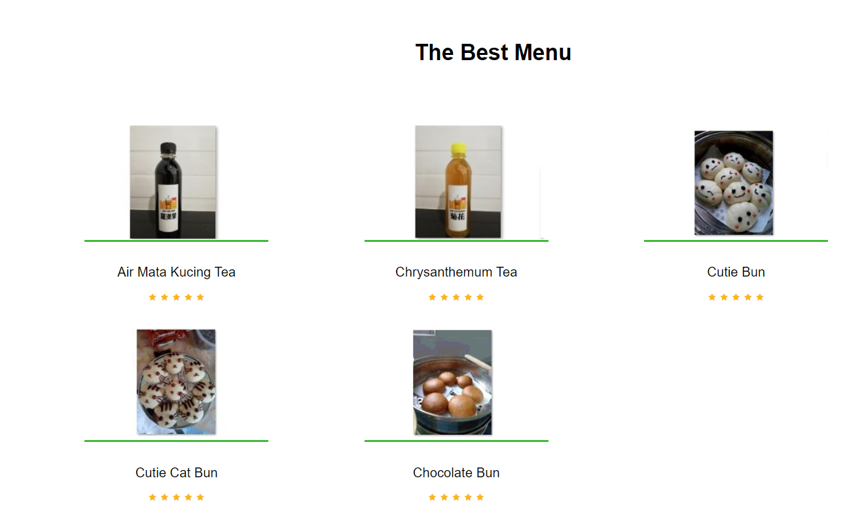
Home Page Function
In the below Home Page will show the menu picture and ranking.

Slide 70
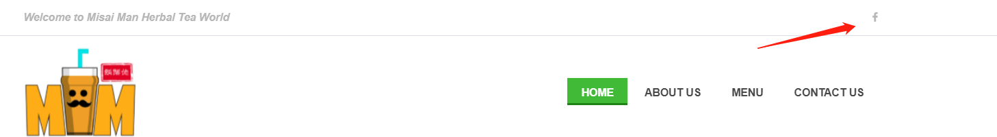
Home Page Function
At the top of the Home page, it will show the “f” icon. This icon is let the customers to click the link to access Misai Man company social media Facebook.

Slide 71
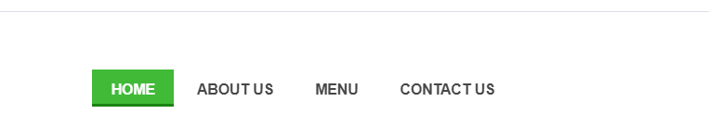
Home Page Function
At the top of Home Page, it shows the 4 tabs to let the customer to choose the content in the page.

Slide 72
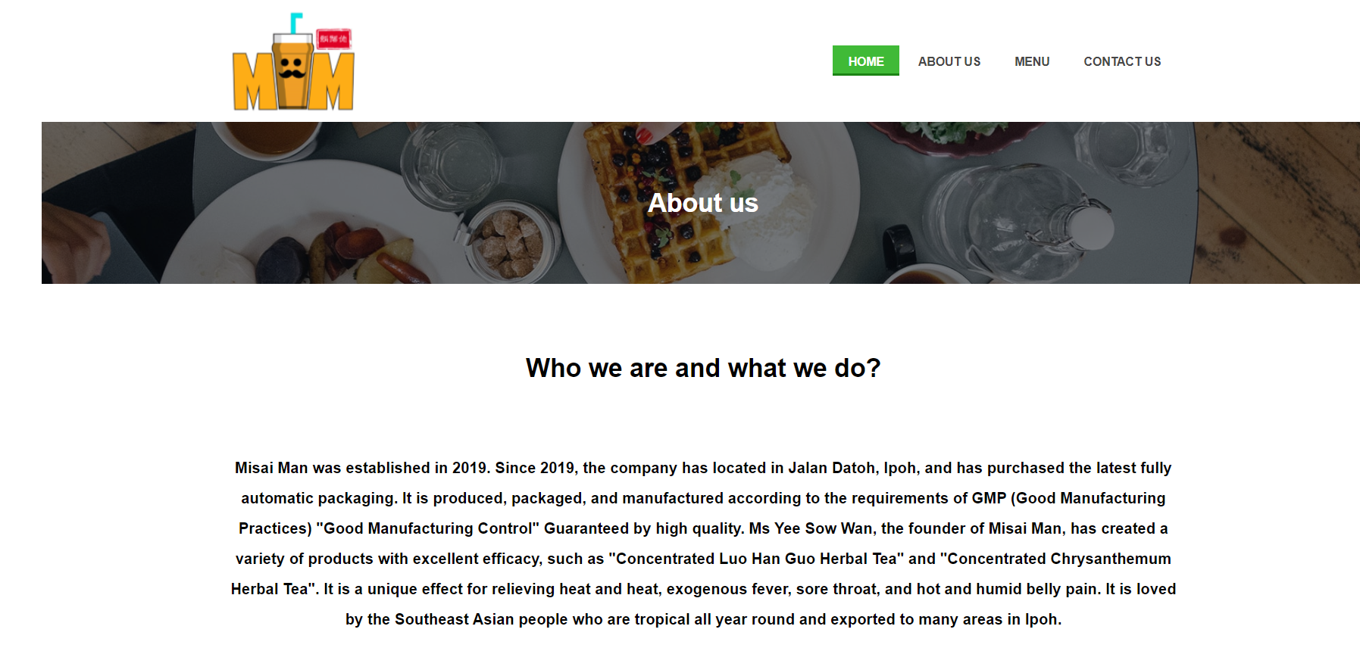
About Us Page
In the About Us page, this page will introduce the Misai Man company the background details.

Slide 73
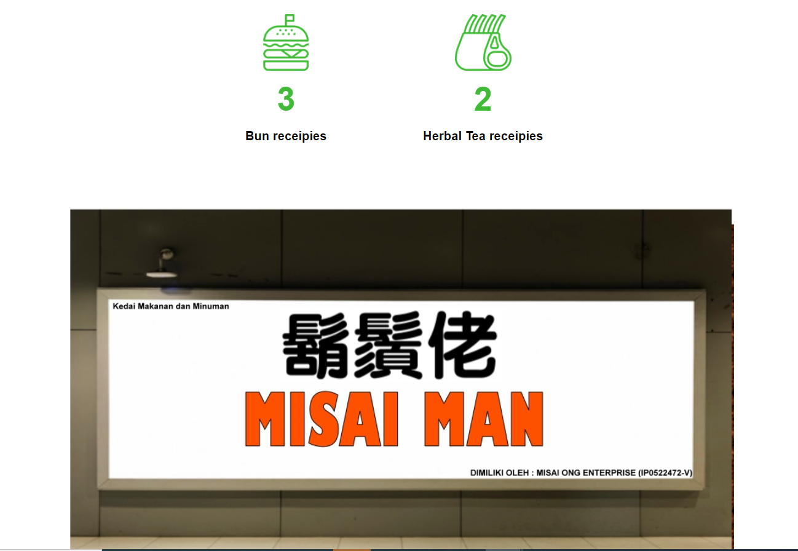
About Us Page
In the below the about us page, two logos will count how many products for the Misai Man company. For example, the bun receipies have three types and the herbal tea receipies have 2 types.

Slide 74
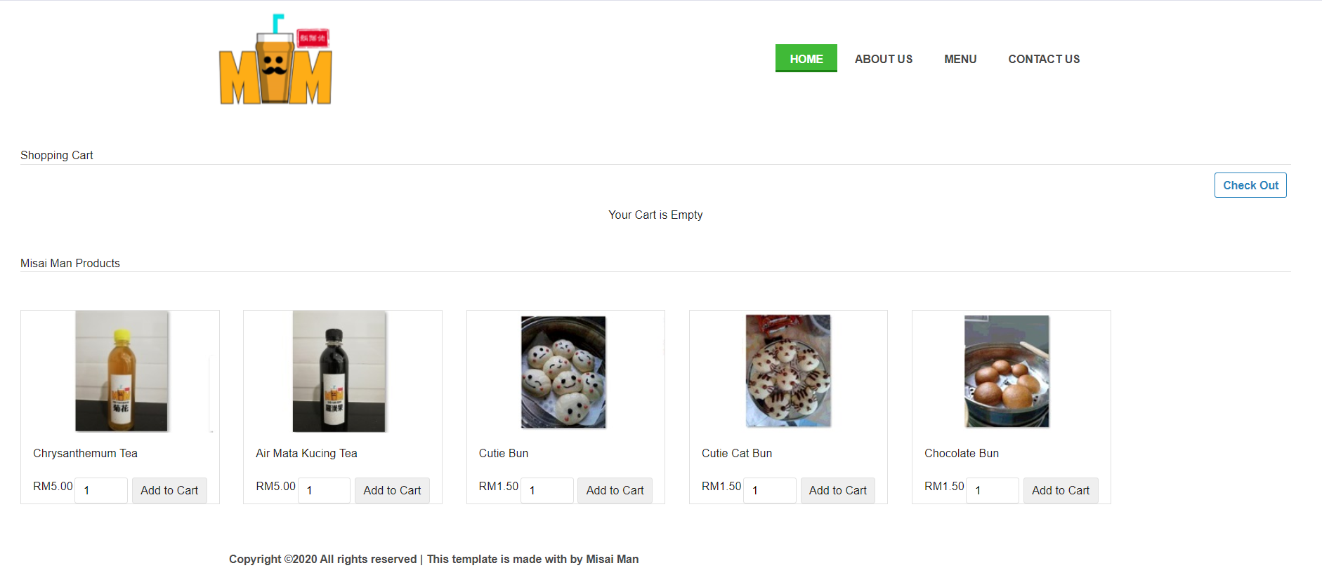
Menu Page
In the menu page, all the product will show in this page. It will show the product name, price and the amount.

Slide 75
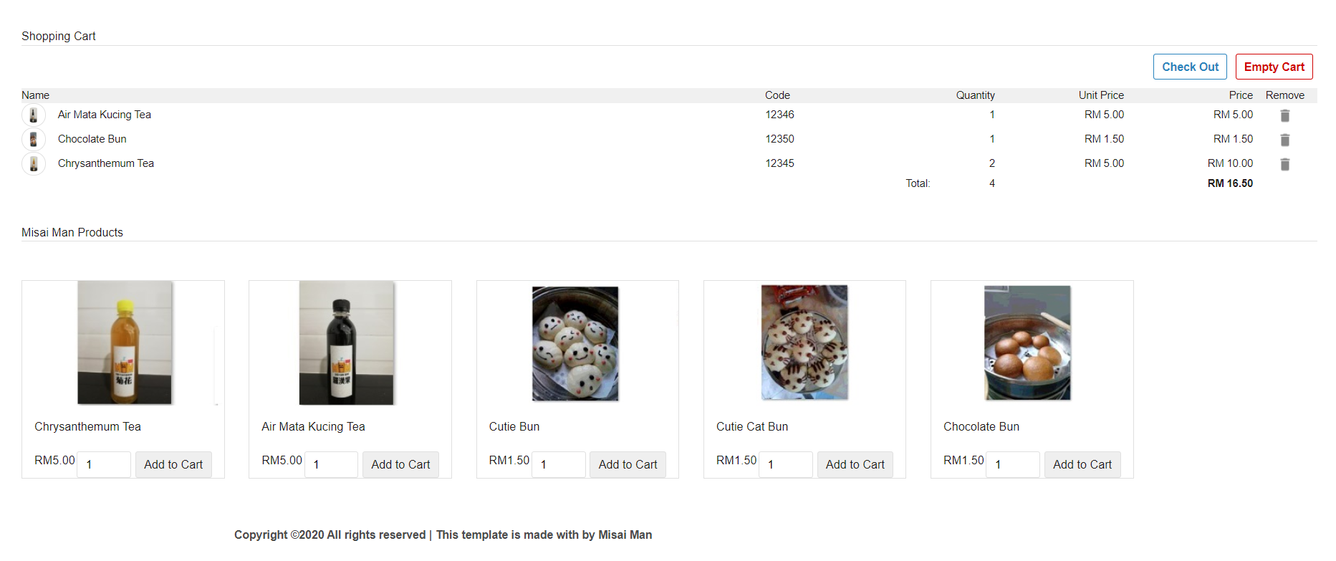
Menu Page Function
After the customer to choose the amount of the product, the list of choose the products will show in the above shopping cart. In the shopping cart, the customer can remove and add the products again. It also will show the total quantity and the price in the shopping cart.

Slide 76
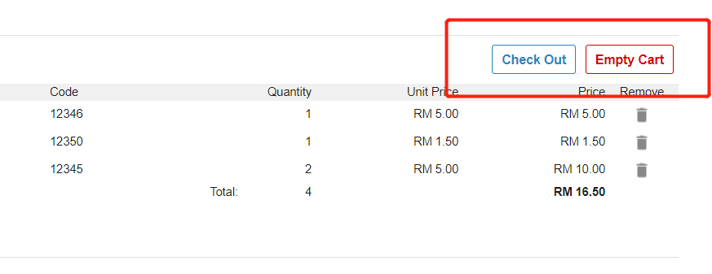
Menu Page Function
The empty cart button can let the customer direct to clear all the selected the products. The checkout button is turned to the next page after finish to select the items.

Slide 77
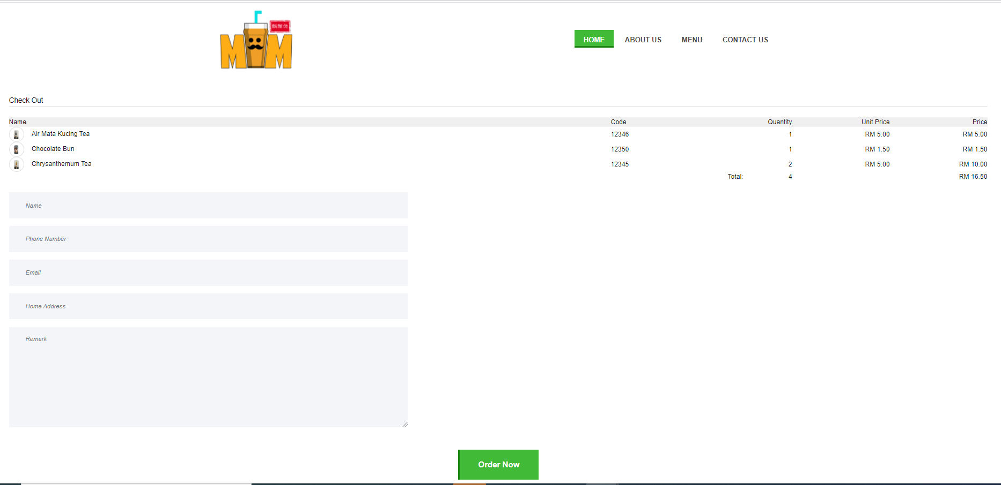
Menu Page (Checkout Function)
After customers clicked the checkout button, they will bring the customer to the checkout page. The customers can double-check their purchase the details of the product in the checkout page, and insert their details then click the “Order Now” to submit to the admin.

Slide 78

Menu Page (Checkout Function)
After clicking the “Order Now” button, the system will show the message “order success” for the customers.

Slide 79

Contact Us Page Function
In the contact us page, this page will show the company address, phone and the email for the customer view.

Slide 80

Contact Us Page Function
In the below the contact us page, it can get in touch with the customer. Customer can fill in the feedback, after click the “Send” button, the message will send to the administrator to check.

Slide 81
Admin Page
In the admin page, the administrator need to insert URL is localhost/misaimanmalaysia/admin.php to access the admin page. The admin page can check the purchase record and the feedback from the customer.

Slide 82

Admin Page Function
In the admin page, the administrator at the top page can view the order details from the customers. The administrator can click the accept, reject and view the action in the order details table.

Slide 83

Admin Page Function
The administrator clicks the accept button, the status will change the “accept” word, if the administrator clicks the “reject” button the status will change show the “reject” message.

Slide 84

Admin Page Function
The administrator click the view button, the administrator can view the this customer order details. After view the details, can click the “Back” button to back the preview page.

Slide 85

Admin Page Function
In the below the admin page, all the contact us details will show in the table.
Note: Misai Man company will later upgrade the existing website system. The current practice is that they will require double verification with customers before delivery to collect payment or electronic payment after payment.

Slide 86
REQUIREMENT

Slide 87
HARDWARE REQUIREMENT
The hardware required to run and develop the Misai Man E-commerce website are as follows.
Description | Requirements
Processor | Intel (R) Core (TM) i5-7200U CPU @ 2.50GHz 2.70Ghz
Random Access Memory (RAM) | 8.00 GB
Hard Disk Drive | 915GB
System Type | 64-bit Operating System, x64-based processor
Laptop | HP Pavilion - 15-cs3069tx

Slide 88
SOFTWARE REQUIREMENT
The software required to run and develop the Misai Man E-commerce website are as follow.
Description | Requirements
Operating system | Microsoft Windows 10
Random Access Memory (RAM) | 8.00 GB
Internet browser | Internet Explorer 8 or newer, Mozilla Firefox or Google Chrome
Server program | PHPMYADMIN, MYSQL, XAMPP, APACHE
Designing Tool | Microsoft Paint, GIMP
CSS, HTML,JQUERY,PHP Editor | Notepad++v7.7.1 (32-bit)
Template | Bootstrap

Slide 89
Youtube Demo Project URL
https://youtu.be/qqqh3pysHOo
All source codes and the install guideline in this link https://github.com/ason5861/5PSEP1Z__051150012_FYP .

Slide 90
THE END

